Slide 1
Chapter 1
Keys to Success in Engineering Study

Slide 2
Chapter Overview
You can do it!
What is “success”?
Goal setting
Strengthening your commitment
Keys to success in engineering study
Models for viewing your education
Structure your life situation

Slide 3
You Can Do It!
Poorly prepared students have succeeded
Highly qualified students have failed
What makes the difference?

Slide 4
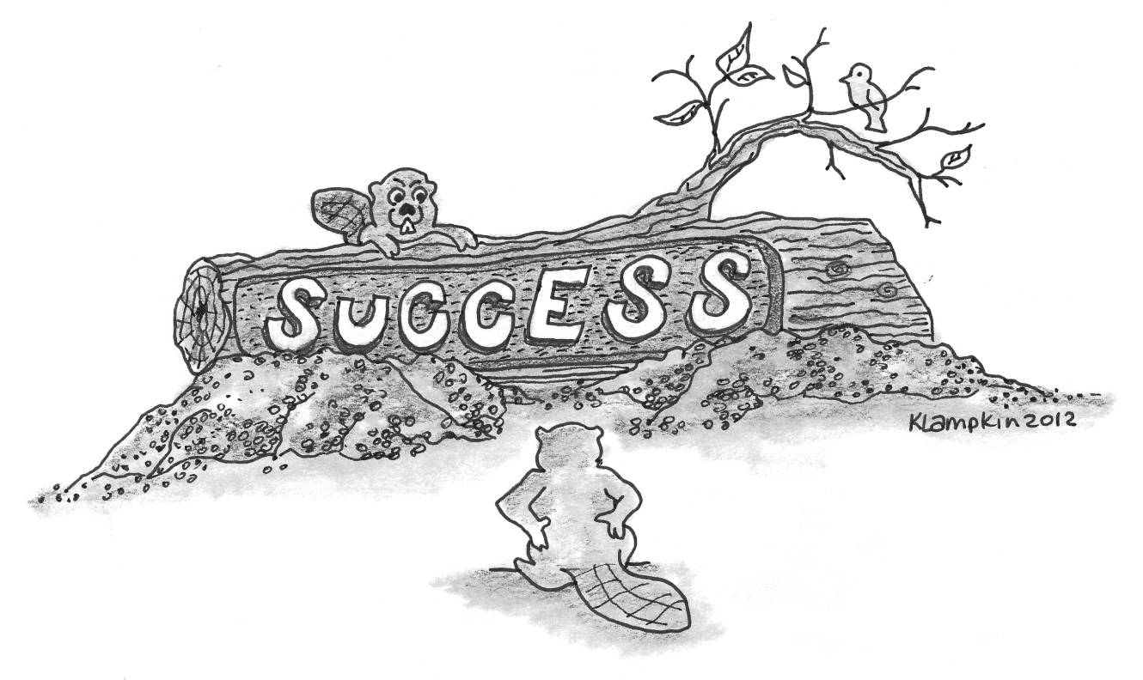
What is Success?
Success is the achievement of something desired, planned, or attempted.

Slide 5
Goal Setting
How can you ever expect to get somewhere if you don’t know where you want to go?
Goals give you something to measure yourself against
Goals give your life direction
Write down your goals

Slide 6
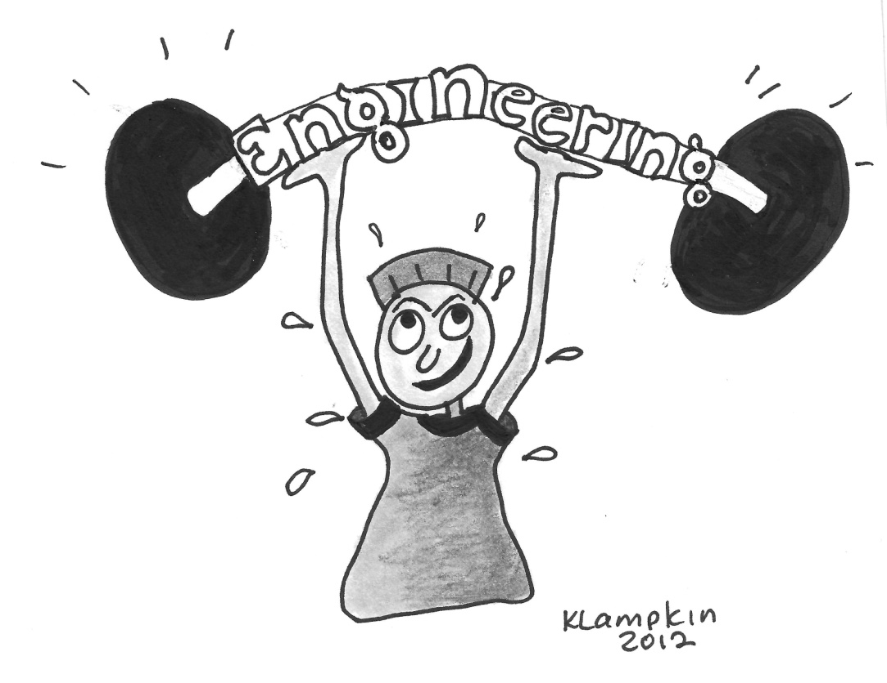
Strengthening Your Commitment
Clarifying your goals
Learning as much as you can about engineering
Prepare a road map
Don’t let adversity stop you

Slide 7
Keys to Success in Engineering Study
Effort – “Work Hard”
Approach – “Work Smart”
Attitude – “Think Positively”

Slide 8
Achievement
Talent x Effort = Skill (1)
Skill x Effort = Achievement (2)
Substituting Skill from eq. (1) into eq. (2):
Talent x (Effort)² = Achievement
Without effort, skill and talent are useless.

Slide 9
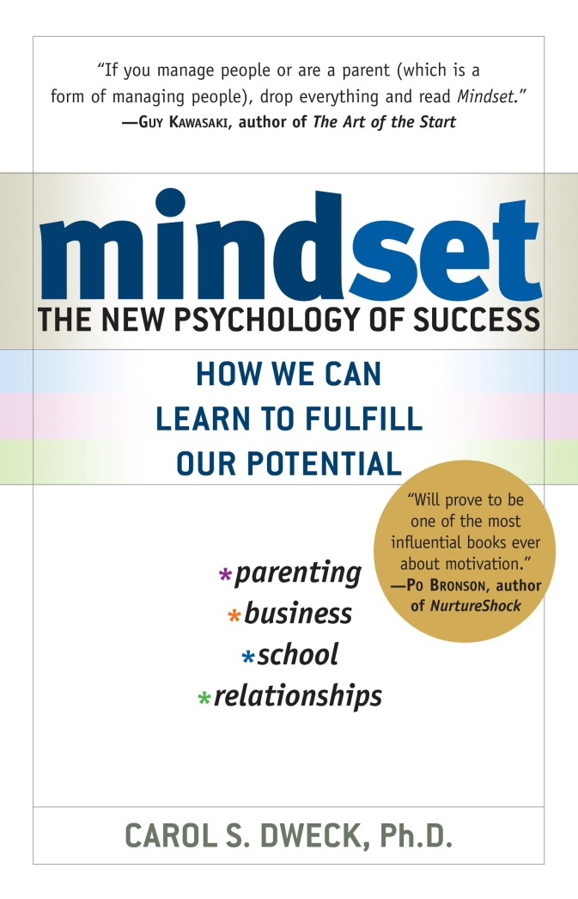
Mindset: The New Psychology of Success by Carol S. Dweck
Fixed mindset – Your qualities (intelligence, personality, moral character) are carved in stone. Creates an urgency to prove yourself over and over.
Growth mindset – Your basic qualities are things you can cultivate and develop through your efforts. Creates a desire to grow and improve.

Slide 10
Comparison of Fixed vs. Growth Mindset
 | Fixed Mindset | Growth Mindset
Challenges | Avoid challenges; stick to what you know well | Embrace challenges; overcoming challenges makes you stronger, smarter
Obstacles | Give up easily when you encounter obstacles | Persist in the face of setbacks; failure is an opportunity to learn
Effort | See effort as unpleasant and fruitless; the need for effort is a sign of low ability | See effort as the path to growth and mastery
Criticism | Ignore useful criticism; see negative feedback as an insult | Seek feedback and learn from criticism
Success of Others | Feel threatened by the success of others | Find lessons and inspiration in the success of others

Slide 11
Attitude – Think Positively
Positive attitudes produce positive results
Negative attitudes produce negative results

Slide 12
Grit: The Power of Passion and Perseverance by Angela Duckworth
The secret to achievement is a special blend of passion and persistence – called grit.
Develop your grit by aligning your interest, practice, purpose and hope with your goals.

Slide 13
Summary of the Success Process
Step 1: Setting goals | Do I want to be an engineer?
Step 2: Strengthening commitment to goals | How important is it to me to become an engineer?
Step 3: Changing negative attitudes | What attitudes will interfere with my goal of becoming an engineer?
Step 4: Changing non-productive behaviors | What do I need to do differently to achieve my goal of becoming an engineer?

Slide 14
Models for Viewing Your Education
Attributes Model – What knowledge, skills, and attitudes will you have when you graduate?
Employment Model – What do employers look for in new engineering graduates?
Student Involvement Model – What can you do to ensure that you get a quality education?

Slide 15
Attributes Model – ABET Attributes of Engineering Graduates
An ability to identify, formulate, and solve complex engineering problems by applying principles of engineering, science, and mathematics.
An ability to apply engineering design to produce solutions that meet specified needs with consideration of public health, safety, and welfare, as well as global, cultural, social, environmental, and economic factors.
An ability to communicate effectively with a range of audiences.

Slide 16
Attributes Model – ABET Attributes of Engineering Graduates (cont.)
An ability to recognize ethical and professional responsibilities in engineering situations and make informed judgments, which must consider the impact of engineering solutions in global, economic, environmental, and societal contexts.
An ability to function effectively on a team whose members together provide leadership, create a collaborative and inclusive environment, establish goals, plan tasks, and meet objectives.
An ability to develop and conduct appropriate experimentation, analyze and interpret data, and use engineering judgment to draw conclusions.
An ability to acquire and apply new knowledge as needed, using appropriate learning strategies.

Slide 17
Astin’s Student Involvement Model
Time and energy devoted to studying
Time spent on campus
Participation in student organizations
Interaction with faculty members
Interaction with other students

Slide 18
Employment Model
Communicates effectively in a variety of different ways, methods, and media
Possesses the ability to think both critically and creatively
Shows initiative and demonstrates a willingness to learn
Functions effectively on a team
Possesses the ability to think both individually and cooperatively
Demonstrates an understanding of engineering, science, and mathematics fundamentals
Demonstrates an understanding of information technology, digital competency, and information literacy
Maintains a positive self-image and possesses positive self-confidence

Slide 19
Structure Your Life Situation
Living Arrangements
Part-Time Work (60-hour rule)
Influence of Family
Influence of Friends
Other influences?

Slide 20
Group Discussion Exercise Ability vs. Effort
Divide into groups of five or six and discuss the following issue:
Do you believe that people succeed because of their ability, that some people “have it” while others don’t?
Or do you believe that people succeed because of their effort?
Which do you think is more important: ability or effort? Why?
Select a group leader to keep the discussion on topic and a recorder who will report out for the group

Slide 21
Alternate Group Discussion Exercise - Fixed Mindset vs. Growth Mindset
People generally have one of two “mindsets”
Fixed mindset - You believe your talents and abilities are set in stone, either you have them or your don’t
Growth mindset – Talents can be developed and great abilities are built over time
Discuss the implications of having each of these mindsets for success in engineering study
Appoint a group leader to keep on topic and a reporter to report out on what was discussed

