Slide 1
Chapter 2
The Engineering Profession

Slide 2
Chapter Overview
What is Engineering?
The Engineering Design Process
Rewards and Opportunities of an Engineering Career
Greatest Engineering Achievements of the 20th Century
Engineering Disciplines
Engineering Job Functions
Employment Opportunities
Important Fields for the Future
Sustainability
Engineering as a Profession

Slide 3
What is Engineering?
If someone (father, grandmother, aunt, friend, fellow student) asked you the question: “What is engineering?” - How would you respond?
“Engineering is the profession in which a knowledge of the mathematical and natural sciences, gained by study, experience, and practice, is applied with judgment to develop ways to utilize, economically, the materials and forces of nature for the benefit of [hu]mankind.”

Slide 4
Learning More about Engineering
Study Chapter 2 of Studying Engineering
Search the web
Talk to engineering professionals
Attend career days
Other?

Slide 5
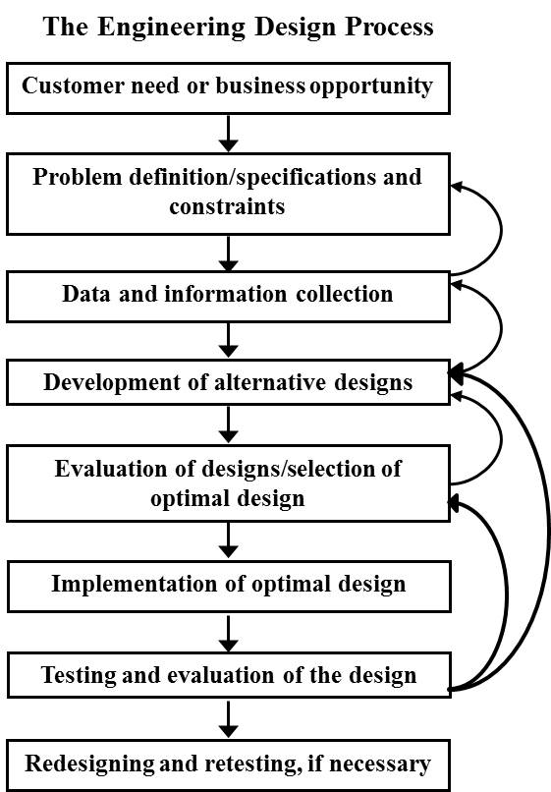
The Engineering Design Process

Slide 6
How Things Work
Internet (e.g., www.howstuffworks.com)
Trade magazines (e.g., Popular Mechanics, PC World, etc.)
Engineering society websites and magazines (e.g., www.spectrum.ieee.org)
Reverse engineering

Slide 7
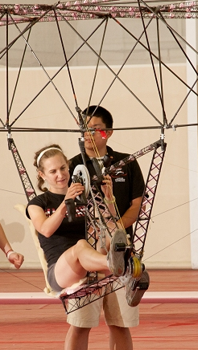
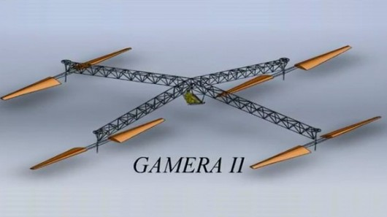
Case Study – Human-Powered Helicopter
Example on how the design process is implemented

Slide 8
Job Satisfaction
Number one cause of unhappiness among people in the U.S.
Financial problems?
Relationship problems?
Health problems?
Job dissatisfaction?
What is it about engineering that is so satisfying?
No
No
No
Yes!

Slide 9
Rewards and Opportunities of an Engineering Career
Financial security
Varied opportunities
Understanding how things work
Social impact
Intellectual development
Challenging work
Creative thinking
Self esteem
Professional environment
Prestige
and many more…
What rewards, benefits, and opportunities excite you?

Slide 10
Varied Opportunities
The day you walk down the aisle to receive your degree in engineering, you have closed no doors.
There is nothing you cannot become from that day forward!!!

Slide 11
People Educated as Engineers
Engineer | Profession
Jimmy Carter | President of the United States
Alfred Hitchcock | Film Director/Producer
Eleanor Baum | First Woman Dean of Engineering
Herbie Hancock | Jazz Musician
Frank Capra | American Film Director
Paul MacCready | Inventor/Winner of Kremer Prize
Ellen Ochoa | Space Shuttle Astronaut
Hyman G. Rickover | Father of the Nuclear Navy
Bill Nye | Host of TV Show “Bill Nye, The Science Guy”
Boris Yeltsin | President of Russia
Alexander Calder | Sculptor
Bill Koch | Yachtsman/Captain of America Cup Team

Slide 12
Engineer | Profession
W. Edwards Deming | Father of Modern Management Practice (TQM)
Grace Murray Hopper | U.S. Navy Rear Admiral/Computer Engineer
Ming Tsai | Restaurateur and Star on TV’s Food Network
Hu Jintao | President of the People’s Republic of China
Montel Williams | Syndicated Talk Show Host
John H. Sununu | Political Pundit/Governor of New Hampshire
Samuel Bodman | U.S. Secretary of Energy
Donald Thompson | CEO and President, McDonald’s Corp.
Rowan Atkinson | British Actor/Comedian/Screenwriter
Rudolph Diesel | Inventor of the Diesel Engine
Michael Bloomberg | Billionaire/Mayor of New York City
Lonnie G. Johnson | Inventor (SuperSoaker®)
A. Scott Crossfield | X-15 Test Pilot
Don Louis A. Ferre | Governor of Puerto Rico

Slide 13
Engineer | Profession
Yasser Arafat | Palestinian Leader/Nobel Peace Prize Laureate
Tom Landry | Dallas Cowboys’ Head Coach
Igor Sikorsky | Inventor of Single Rotor Helicopter
Mohamed Morsi | President of Egypt
Shiela Widnall | Secretary of the Air Force
David A. Wolf | Astronaut/Medical Doctor/Electrical Engineer
Robert A. Moog | Father of Synthetic Music
Chester Carlson | Inventor of Xerox Process
John A. McCone | Director of Central Intelligence Agency
Arthur C. Nielsen | Developer of Nielsen TV Ratings
And many more…

Slide 14
Financial Reward Starting Salaries for 2018 Bachelor’s Degree
Discipline | Average Salary
Engineering | $66,521
Mathematics and Sciences | $61,867
Computer Sciences | $60,005
Business | $56,720
Humanities & Social Sciences | $56,669
Agriculture and Natural Resources | $53,565
Communications | $51,448
Average for All Disciplines | $44,259

Slide 15
Prestige
Engineers are critical to:
International competitiveness
Standard of living
National security
Personal health
Public safety

Slide 16
Greatest Engineering Achievements of 20th Century
20. High performance materials
19. Nuclear technologies
18. Laser and fiber optics
17. Petroleum and gas technologies
16. Health technologies
15. Household appliances
14. Imaging technologies
13. Internet
12. Space exploration
11. Interstate highways

Slide 17
Greatest Engineering Achievements of 20th Century
10. Air-conditioning and refrigeration
9. Telephone
8. Computers
7. Agricultural mechanization
6. Radio and television
5. Electronics
4. Safe and abundant water
3. Airplane
2. Automobile
1. Electrification

Slide 18
Engineering Disciplines
Discipline | B.S. Degrees Awarded in 2016
Mechanical engineering | 29,751
Electrical and electronics engineering | 16,0165
Civil engineering | 14,457
Chemical engineering | 9,898
Computer engineering | 6,671
Bioengineering and biomedical engineering | 6,607
Industrial engineering | 5,063
Aerospace engineering | 3,967
General engineering | 3,431
All other engr. disciplines | 13,224

Slide 19
Engineering Job Functions
Analysis
Design
Test
Development
Sales
Research
Management
Consulting
Teaching
Entrepreneurship

Slide 20
Employment Areas for Individuals with Engineering Degrees
Employment Area | Percentage
Business/Industry | 64.5%
Federal Government | 4.6%
State/Local Government | 6.2%
Educational Institutions | 18.5%
Self-Employed | 6.2%
Total | 100%

Slide 21
Manufacturing Industry Sectors Employing Largest Number of Engineers
Computer and electronic product
Transportation equipment
Machinery
Fabricated metal product
Chemical
Electronic equipment, appliance, and component

Slide 22
Non-manufacturing Industry Sectors Employing Largest Number of Engineers
Professional, scientific, and technical services
Information
Construction
Wholesale trade
Administrative and support
Management of companies and enterprises
Utilities
Mining

Slide 23
50 Greatest Technological Inventions of Past 25 Years
50 to 41 | 40 to 31 | 30 to 21 | 20 to 11 | 10 to 1
Hybrid cars | Lithium rechargeable batteries | Home audio editing | JPEG | Genetic sequencing
Mini disc | DVD | Home video editing | Microblogging | Web-based email
Color plasma display | CD-R | Camcorders | Caller ID | Search engines
Optical computer mouse | Voice mail | Digital SLR cameras | Mobile broadband | Smart phones
LED headlights | Online stock trading | Multi-core processors | Blogs | Text messaging
Electronic tolls | Doppler radar | Satellite radio | MP3 players | Wi-Fi
OLED TV | MPEG-4 | Flip phones | Electronic word processing | MP3
Blu-ray | Flash memory | Digital HDTV | DVR | Broadband Internet
Satellite TV | Bluetooth | Instant messaging | DNA profiling | Personal computers
Recordable DVDs | Commercialized GPS | Consumer digital cameras | Social networking service | World Wide Web

Slide 24
Major Events and Changes Affecting the Future
Industrial disasters, such as oil spills or nuclear accident
Advances in computer technology
Advances in communications and internet
The knowledge and information explosion
Globalization (outsourcing, off-shoring)
Environmental challenges/sustainability
World population explosion
Displacement of people due to famine and war
Social and economic injustice
Pandemic diseases/drug resistance germs
Climate change/natural disasters
Nuclear proliferation
Events of September 11, 2001/threat of terrorism

Slide 25
14 Grand Challenges for Engineering
Make solar energy economical
Provide energy from fusion
Develop carbon sequestration methods
Manage the nitrogen cycle
Provide access to clean water
Restore and improve urban infrastructure
Advance health informatics

Slide 26
14 Grand Challenges for Engineering (continued)
Engineer better medicines
Reverse-engineer the brain
Prevent nuclear terror
Secure cyberspace
Enhance virtual reality
Advance personalized learning
Engineer the tools of scientific discovery

Slide 27
Sustainability
Sustainability is meeting the needs of the present without compromising the ability of future generations to meet their own needs.

Slide 28
Sustainability Major environmental problems
Global warming/climate change
Ozone depletion
Water quality and quantity
Air pollution
Dependence on fossil fuels/energy crisis
Unsustainable agriculture
Threat of disease
Waste management and land pollution
Over-consumption
World hunger
Loss of ecosystems/deforestation/animal extinction
The significant problems we face cannot be solved at the same level of thinking we were at when we created them. – Albert Einstein

Slide 29
Attributes of “Green Engineering” and Sustainable Designs
Designs that use less energy or reduce emission
Designs with minimal carbon footprints
Designs that reduce material usage or waste in manufacturing
Designs with no toxic materials
Designs that comply with environmental standards and regulations
Manufacturing processes that use less energy and natural resources
Products that can be disposed of safely, including biodegradable materials and packaging
Manufacturing processes that minimize the usage or production of substances of concern
Designs that use renewable/recyclable/recycled materials
Products that require less packaging

Slide 30
Engineering as a Profession
Characteristics of a learned profession
Professional registration
Graduation from ABET-accredited engineering program
Pass Fundamentals of Engineering Exam (FE)
Complete four years of acceptable engineering practice
Pass the Principles and Practice of Engineering (PE) Exam
Professional societies

Slide 31
Group Discussion Exercise Motorized Beach Wheelchair
Working in your group, develop a list of specifications for a motorized wheel chair that could be used on a sandy beach.
Appoint a leader to keep the discussion on topic and a recorder to record and report what you come up with

Slide 32
Alternative Group Discussion Learning More About Engineering
In your group, “brainstorm” a list of tangible things you can do to learn more about engineering. Be bold and creative!
Appoint a leader to keep the discussion on topic and a recorder to record and report what you come up with.

