Slide 1
Chapter 4
Making the Most Out of How You Are Taught

Slide 2
Chapter Overview
Early course preparation
Preparing for lectures
During your lectures
Making effective use of your professors
Utilizing tutors and other academic resources

Slide 3
Early Course Preparation
Start of a course can be likened to the start of a race
Any hesitation at the start will result in you trying to catch up during the whole race
Using the course syllabus
Contains all the important information about the course → study it thoroughly
Acquiring textbooks and other materials

Slide 4
Preparing for Lectures
Review notes, read text, attempt problems, formulate questions
Little like “warming up” for a physical workout
Makes lectures a reinforcement rather than an initial exposure
Small effort can have a big payoff

Slide 5
During Your Lectures
Sit near the front
“Be here now” (concentrate)
Practice good listening skills
Take good notes
Ask questions in class
Eliminate distractions

Slide 6
Listening Skills
Poor Listener | Good Listener
Tunes out uninteresting and boring topics. Turns off quickly. | Works at finding value in all topics. Listens to discover new knowledge.
Tunes out if delivery is poor. | Judges value of the content rather than the delivery.
Listens for facts and details. | Listens for central themes. Uses them as anchor points for the entire lecture.
Brings little energy to the listening process. | Works hard at listening; remains alert.
Readily reacts with opposing views to new ideas. Starts listening to themselves when they hear something they don’t agree with. | Focuses on understanding completely rather than coming up with opposing views.
Bothered by distractions. | Fights distractions; ignores bad habits of other students; knows how to concentrate.
Resists difficult material; prefers light recreational material. | Welcomes difficult material as exercise for the mind.
Interrupted by emotionally-charged words or ideas. | Does not get hung up on emotionally-charged words or ideas; listens with an open mind.
Daydreams and lets mind wander off with slow speakers or gaps in presentation. | Uses extra time to think more deeply about what the lecturer is saying; summarizes what has been covered.

Slide 7
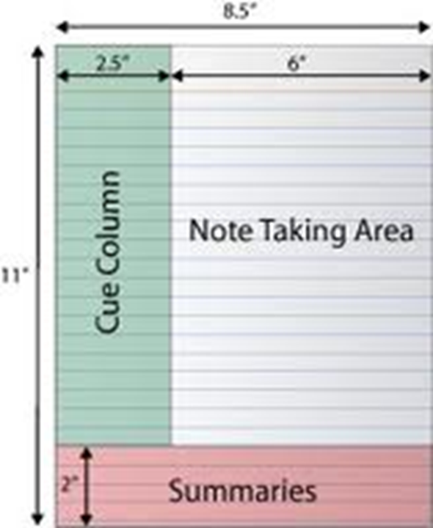
Note-Taking
Good notes give you a record of what’s important
Spiral notebook vs. three-ring binder
Advantages/disadvantages of taking notes on a computer
Cornell Note-Taking System

Slide 8
Note-Taking Hand written or Typed?
Take notes by hand
On paper or digital pen on tablet (if allowed)
Notes written by hand require a complex cognitive process
Information is retained better compared to typing notes
Focus on what’s important, main ideas
Will enhance your review process

Slide 9
Asking Questions in Class
Memory level questions
Who, what, where, when
Convergent thinking questions
Why, how, in what ways
Divergent thinking questions
Imagine, suppose, predict, if…then, how might,…
Evaluation thinking questions
Defend, judge, justify, what is your opinion about…

Slide 10
Making Effective Use of Your Professors
Important roles your professors can play
Characteristics of your professors you can count on
Behaviors to avoid
Winning behaviors

Slide 11
Important Roles for Your Professors
One-on-one instruction
Academic advising, career guidance, personal advice
Monitor your progress; hold you accountable
Give you the benefit of the doubt on borderline grades
Help you find a summer job
Hire you on their research grant
Serve as a reference
Nominate you for scholarships or academic awards

Slide 12
Characteristics of Your Professors
Believe their areas of technical specialty are important and interesting
Chose an academic career over professional practice; believe they are outstanding teachers
Are very knowledgeable, and love to convey what they know to others

Slide 13
Behaviors to Avoid
Coming late to class
Yawning or sleeping in class
Talking in class
Using your smartphone or computer in class for non-class related things, e.g. messaging, playing games, doing homework etc.
Leaving class early
Failing to do assigned homework
Complaining that exams are too hard or grading was unfair

Slide 14
Winning Behaviors
Make sure you know the names of your Professors
Make sure your Professors know your name
Tell your Professor you like the course and the topics and that you appreciate the good job the Professor is doing in teaching the course
Visit Professors during their office hours

Slide 15
Winning Behaviors How to talk to your Professor?
Adapt the “Six Ways to Make People Like You”:
Become genuinely interested in your Professors
Smile
Call your Professors by their title and name
Be a good listener, ask the Professors to talk about their research, area of expertise, etc.
Talk in terms of your Professors interest
Make your Professors feel important, and do so sincerely

Slide 16
Understanding What Your Professors Do
Teaching
Research
Service

Slide 17
Communicating with Professors by Email and Text Messaging
Emailing Your Professors
Write from your college or university account
Include the course number in your subject line
Use an appropriate greeting
Be clear, concise, and polite
Don’t ask things in your email that you can readily find yourself, e.g. in the Syllabus or the course page
Proofread your email
Sign with your full name
Texting Your Professors
Not a very common communications method
Some Professors might use blog posts on the course page

Slide 18
Utilizing Tutors and Other Academic Services
Tutoring: Opportunity to have a dialogue with an expert on a subject you want to learn
Recitation/Problem-Solving Sessions: Attempt and study material before attending to get the greatest benefit from sessions
Academic resource center: tutoring, writing skills, study skills, etc.
Library: books, periodicals, on-line materials, reference librarians
Student computer labs: hardware, applications software, Internet access, resource materials, training
Academic advising: monitor progress, course planning and selection
University catalog: Rules and regulations, college and department information, curricular requirements, course descriptions
Registrar’s office: transcripts, registration information

Slide 19
Group Discussion Topic Making Effective Use of Your Professors
In your group, develop a list of questions you could ask one of your professors about himself/herself when visiting during office hours. Be creative!
Appoint a leader to keep the discussion on topic and a recorder to write down and report what was learned.

Slide 20
Think-Pair-Share Exercise – Distraction in Class
Take a few minutes and think about what are the major distractions you face during class.
Pair up with the person next to you and:
Tell your partner what distracts you during class
Discuss strategies to avoid becoming distracted
Be prepared to tell the class what you and your partner came up with

