Slide 1
Chapter 5
Making the Learning Process Work for You

Slide 2
Chapter Overview
Skills for learning
Reading for comprehension
Problem solving
Organizing your learning process
Preparing for and taking tests
Making effective use of your peers

Slide 3
Reading for Comprehension
What to do before you read?
What to do while you read?
What to do after you read?

Slide 4
Before You Read
Establish a purpose for the reading
Comprehend principles and concepts
Survey/skim/preview
Headings, figures, charts, drawings, tables, diagrams
Make a list of questions to be answered
Turn headings, subheadings into questions

Slide 5
While You Read
Read actively
Use pen or pencil to make notes
Focus on understanding concepts thoroughly
Don’t focus on examples problems first
Take your time; don’t try to read too fast
Write down questions that need to be answered about anything you don’t understand
Periodically, stop and recite (ideally aloud) what you have read

Slide 6
After You Read
Recite answers to the questions you prepared before you started reading. Reread where needed.
Review within a day; again in a week; when you prepare for an exam; and when you prepare for the final exam
Solve problems
Apply the same principles of before, while and after to material presented in multimedia form, e.g. videos, animations, etc.

Slide 7
Analytical Problem Solving
Step 1 - Understand the problem
Step 2 - Devise a plan
Step 3 - Carry out the plan
Step 4 - Look back

Slide 8
Learning Technique | How to implement
Practice testing | Use provided quizzes or come up with your own practice tests for to-be-learned material.
Distributed practice | Distribute your study time in smaller sessions over a given period of time instead of having one long study session in the same time period.
Interleaved practice | Mix problems; instead of doing all problems related to one topic and then all problems related to the next topic. Mix them up.
Elaborative interrogation and self-explanation | Come up with your own explanation of a concept or theory (“say it in your own words”); state how the new information relates to what you already know; explain each step when you solve a problem.
Summarization | Make summaries of your lecture notes; create your own equation sheets.
Highlighting, underlining | Mark important parts of to-be-learned materials while reading
Rereading | Read over material again after an initial reading

Slide 9
Effective use of Rereading
First Reading
Practice Test
Mastered
all concepts?
No
Re-reading
Yes

Slide 10
Organizing Your Learning Process
Master each Level
Procrastination
Mastering the material
Learn to manage your time
Priority management

Slide 11
Master Each Level
Don’t allow the next class session in a course to come without having mastered the material presented in the previous class session.
Note: This is perhaps the single most powerful academic success strategy!

Slide 12
Procrastination
Procrastination – “Choosing to put off something we know we should be doing and instead do something we know we shouldn’t be doing.”
Reasons for procrastination
Fear of failure
Fear of success
Low tolerance for unpleasant tasks
Disorganized

Slide 13
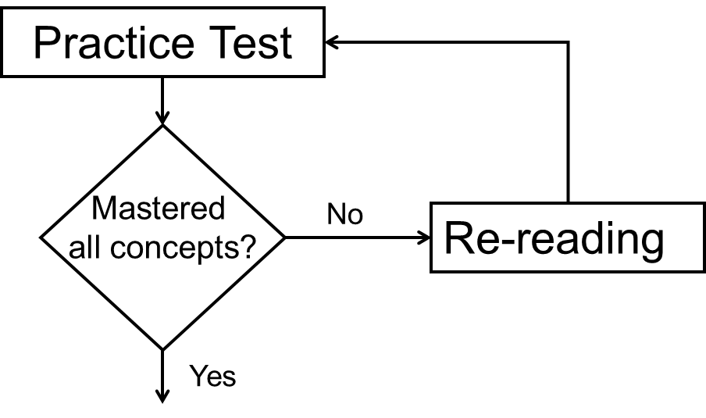
Mastering the Material
Learn from your lecture notes
Reread the text
Solve problems
Study annotate
Question/reduce
Summarize
Recite
Reflect
Review

Slide 14
Desirable Difficulty
You learn more from a task for which you had to put in some effort
Right amount of difficulty (desirable difficulty) will result in improved long-term retention of the material studied
Seek out practice problems which require a certain amount of “struggling”
Avoid doing only easy problems, they are easy because you already mastered the material

Slide 15
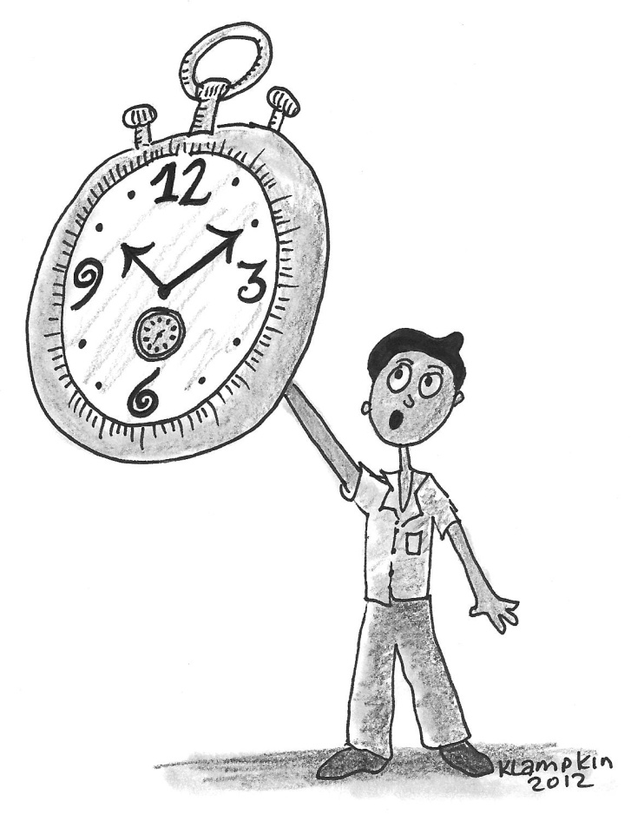
Learn to Manage Your Time
Place a high value on your time
Schedule your time
Make a serious commitment to your study time

Slide 16
Benefits of Scheduling Your Study Time
See if you are overextended
More likely to keep up in your classes
Provide feedback as to how much you are studying
You’ll learn what you can do and can’t do
You’ll feel that you have more time
You’ll feel much less stressed-out over school

Slide 17
How Many Hours Should You Study?
How difficult is the course?
How good a student are you?
How well prepared are you for the course?
What grade do you want to receive?

Slide 18
Making Up Your Weekly Schedule
Block out all of your commitments (classes, meetings, part-time work, time to get to and from school, time for meals, etc.)
Remainder of time is available for one of two purposes – 1) study; or 2) recreation
Schedule your study time to avoid wasting time answering these three questions over and over again:
Should I study now or later?
Where should I study?
What subject should I study?

Slide 19
Make a Serious Commitment to Your Study Time
Your scheduled study time is non-negotiable
Follow through with your schedule will:
Make you feel you actually have more time
Reduce your stress level
Improve your academic performance

Slide 20
Daily and Long Term Planning
Use a “To Do List” for daily/weekly planning
Each evening write down what needs to be done the next day
Prioritize the items on your list from high to low priority
Cross off items form your list as you complete them
Use a long-term planner (paper based or electronically) to track:
Long term commitments, important dates and deadlines, appointments etc.

Slide 21
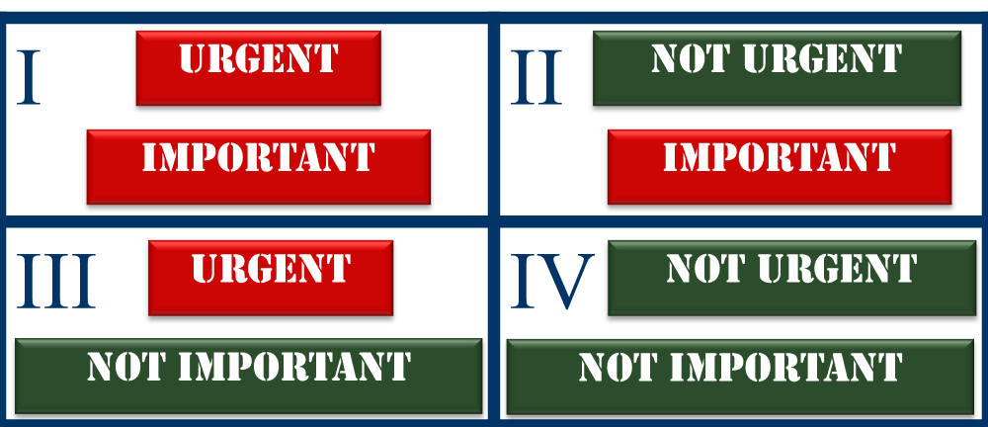
Priority Management
Organize and execute around priorities
Two dimensions – Urgent and Important

Slide 22
Priority Management
Stay out of quadrants III and IV → it is not important!
Quadrant I is crisis management. We can’t ignore urgent and important activities.
Quadrant II is were we want to operate but it requires to give up activities from III and IV.
Choosing Quadrant II activities will reduce the need to always operate in the crisis management mode of Quadrant I

Slide 23
Preparing For Tests
Schedule time for review
“Scope out” tests
Practice under time pressure
Get a good night’s sleep
Make sure you have the right materials and tools
Arrive early

Slide 24
Test-Taking Strategies
Read through the entire exam
Work on problems from easiest to most difficult based on your feeling what is easiest/most difficult
Spend time proportional to points available, 50 points on a 50 minutes exam → spend 1 minute per point, e.g. spent 10 minutes on a 10 point problem
“Get stuck, move on, come back”
If time permits, check and recheck your work and make sure all questions are answered

Slide 25
Test Anxiety
Test anxiety is real and will affect your performance
If you have test anxiety or nervousness try the following:
Spend 10 minutes before an exam jotting down your thoughts and feelings about the exam
This will set aside those thoughts and feelings and free up your working memory
For severe anxiety seek counseling right away

Slide 26
Making Effective Use of Your Peers
Overview of collaborative learning
Benefits of group study
Frequently asked questions

Slide 27
Learning Modes
Solitary – You learn by yourself
Collaborative – You learn with others

Slide 28
Class Poll on Collaborative Learning
How many of you spend some fraction of your study time on a regular basis studying with at least one other student?
How many of you spend virtually 100 percent of your study time studying alone?
For those who study alone – “Why don’t you study with other students?
For those who study with other students – “How is it working for you?”

Slide 29
Why Do Students Study Alone?
I learn more studying by myself.
This contradicts ALL the research that has been done on student success and learning.
I don’t have anyone to study with.
That’s an excuse. Just look around…
It’s not right. You’re supposed to do your own work.
Today everything in industry is collaborative/teamwork → it’s a necessary skill

Slide 30
Benefits of Group Study
You’ll be better prepared for the engineering “work-world”
You’ll learn more
You’ll enjoy it more

Slide 31
Frequently Asked Questions
What percentage of my studying should be done in groups?
Depends on individual, 25-50% is a good start, key is that members come prepared to a meeting
What is the ideal size of a study group?
2-4 persons will work, 2 is the smallest (lack of diversity), 5 might be too large (someone might be left out)
What can be done to keep the group from getting off task?
Set up fixed times, like 45min than 15min break, set a goal what needs to be done, no one leaves before

Slide 32
Group Discussion Benefits of Group Study
In your group, discuss the benefits of working with other students on your academic work.
Appoint a leader to keep the discussion on topic and a recorder to write down and report what was learned

Slide 33
Alternate Group Exercise – Experiential Lesson in Group Work
Assuming an astronaut crash-landed on Mars 100 miles from the nearest outpost. You are the engineer or engineering team giving advise what should be taken from the crash site. These are the items available:
Rank the item in order of importance and provide an explanation for your order.
Food concentrate 50 feet of nylon rope Parachute silk Case of dehydrated milk Two tanks of oxygen Stellar map Box of matches | Self-inflating life raft Magnetic compass Five gallons of water Signal flares Solar powered FM receiver Portable heating unit Box of matches
Note: One-half of the class should divide into groups of 3-5 and work on the problem. The other half of the class should work on the problem by themselves

