Slide 1


Chapter 7
Broadening Your Education

Slide 2
Broadening Your Education
This chapter is about:
Co-curricular/Extra curricular Activities
Things no one will make you do. You will have to take initiative and “step up to the plate” to take advantage of these things
But things that may have greater educational value than even your required coursework.

Slide 3
Examples of
Co-curricular Activities
Participation in student organizations
Participation in engineering projects
Pre-professional employment
Study Abroad
Putting something back (service)

Slide 4

Types of Engineering
Student Organizations
Student chapters of discipline-specific engineering societies
Engineering honor societies
Ethnic and gender-based student organizations
Engineering student council

Slide 5
Benefits of Participation in Student Organizations
Meet your social needs
Develop your leadership and organizational skills
Engage in professional development activities
Receive academic support
Participate in service activities

Slide 6
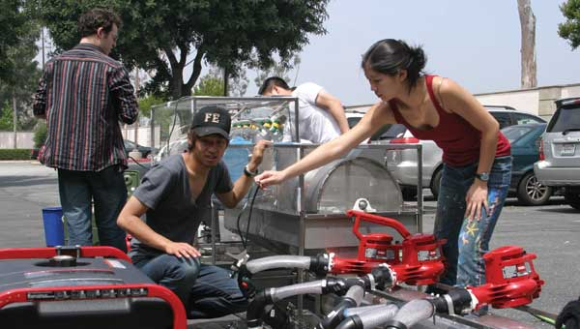
Participation in
Engineering Projects
Student design competitions
Technical paper
contests
Design clinics
Undergraduate Research
  Research Experience for Undergraduates (REU)

Slide 7
Pre-Professional Employment
Summer jobs, Internships
Part-time jobs
Cooperative education (“co-op”) experiences

Slide 8
Benefits of Pre-Professional Employment
Develop job search skills
Gain exposure to engineering practice
Make money
Apply your knowledge, skills, and abilities
Strengthen motivation to succeed in engineering study
Gain references for future employment

Slide 9
Cooperative Education
a program of study at an institution of higher education under which regular students undertake academic study for specified periods of time alternating with work experience in government, industry, business . . .

Slide 10
How Do You Measure Up?
Your year in school
Your academic performance
Your personal qualifications

Slide 11
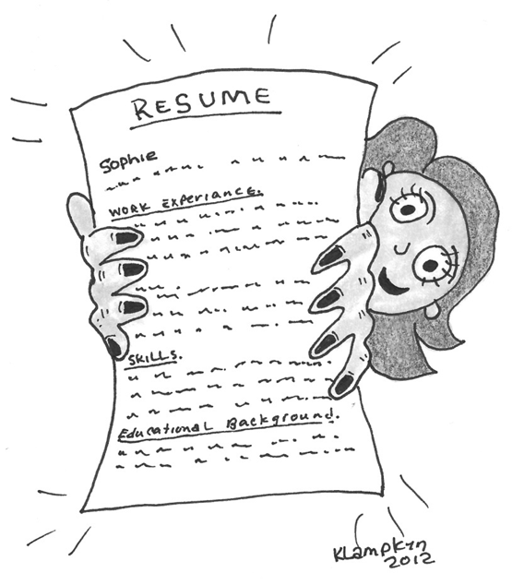
Conducting a Job Search
Preparing a resume
Preparing a cover letter
Developing your interviewing skills
Identifying employment opportunities

Slide 12
Set Up a LinkedIn Profile
Your LinkedIn profile is an online resume
Recruiters from companies use LinkedIn to find potential future employees
Build a strong profile and keep it up to date

Slide 13
Interview Skills
Put significant effort into preparing yourself for interviews
Practice interview questions
Learn as much as you can about the company, the job you are seeking, and the person who will be interviewing you
STAR Strategy for Interviews
  Situation, Task, Action, Result

Slide 14
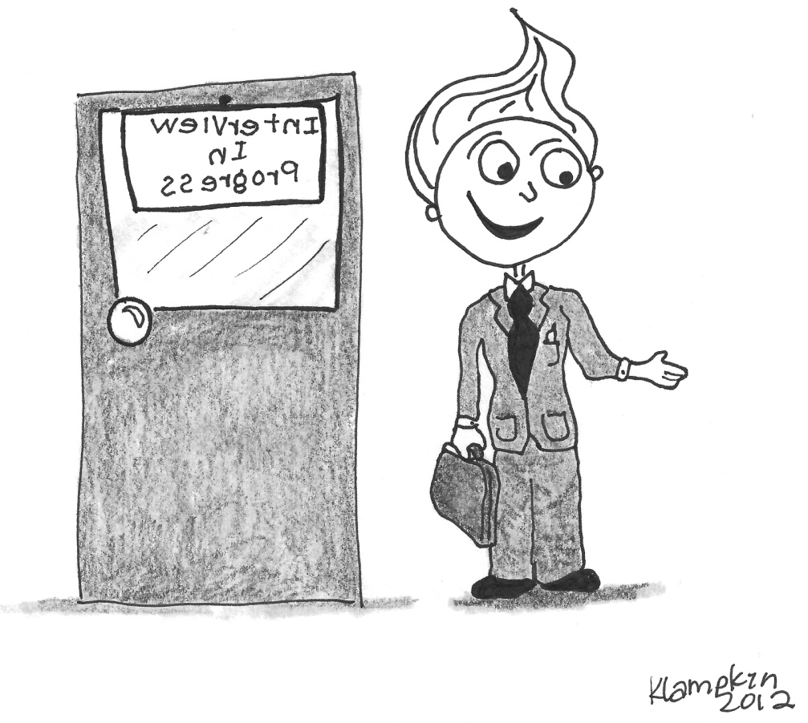

Identifying Employment Opportunities
Networking
Informational Interviews
On-campus interviews
Using the Internet, e.g.
Career fairs and other on campus resources

Slide 15


Slide 16
Informational Interview
What is it?
– An information gathering session. Not a job interview. You are interviewing the employer.
Preparing for the informational interview
Conducting the interview
Following up on the interview

Slide 17

Study Abroad
Benefits
Can You Do It?
Finding a Study Abroad Program

Slide 18
Benefits of Study Abroad
Developing greater self-confidence, independence, self-reliance, and maturity
Broadening your world understanding and gaining a new perspective on the world
Improving your cross-cultural communication skills
Developing your ability to adapt to new and unfamiliar environments
Building second language skills
Making new and lasting contacts and friendships
Distinguishing yourself from your peers in a future job search

Slide 19
Can You Do It?
Length of time abroad
When to go abroad
Host country
Method of financing
What to study while abroad

Slide 20
Finding a Study Abroad Program
Programs sponsored by your university
Programs not sponsored by your university

Slide 21

Putting Something Back
Providing feedback
  Helpful feedback is:
    Descriptive, NOT evaluative
    Specific
    Usable
Serving as an ambassador
Helping other students

Slide 22
Group Discussion
Student “Power”
Power (“the ability to influence others”) comes from at least three sources:
position
knowledge
person
In your group, discuss the “power” that comes to you from your position as a “student”
Appoint a leader to keep the discussion on topic and a recorder to document what was learned and report out

Slide 23
Alternate Group Discussion Topic
Interviewing for Summer Job
In your group, develop a list of 7-10 questions you would expect to be asked during an interview for an engineering-related summer job/internship.
Take turns asking the questions to group members and having them respond.
Appoint a leader to keep the discussion on topic and a recorder to document what was learned and report out

