Slide 1
Prologue
What This Book Has to Offer and How to Get It

Slide 2
Purpose of the Prologue
Convince you of the potential of this course and the book to make a difference in your life
Give you guidance on how to realize that potential

Slide 3
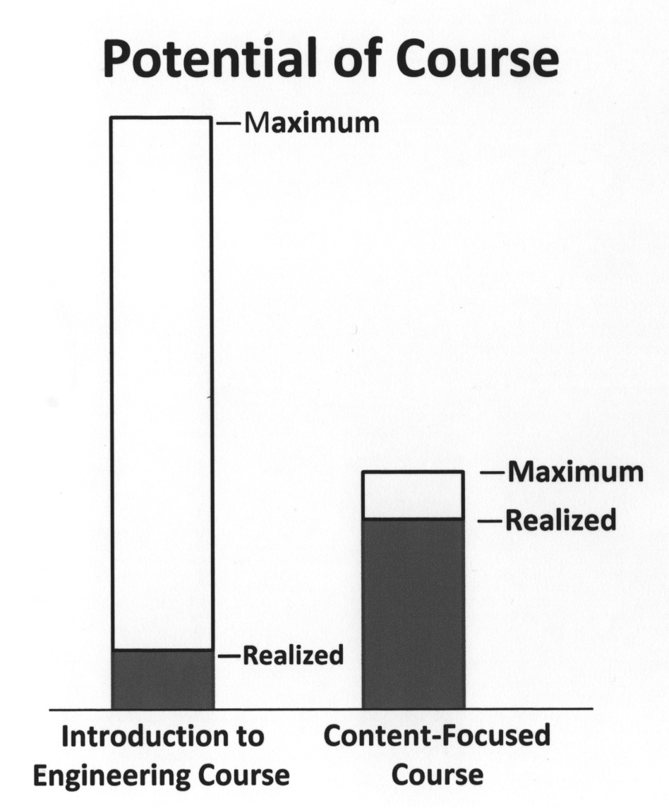
Potential of This Course Compared to an only Content-Focused Course

Slide 4
Payoff for Getting the Maximum Potential Available from This Book
Develop skills that will enhance your success in engineering study
Give you the skills needed to be a successful engineering professional

Slide 5
Mirror Analogy
Purpose of a mirror – To see whether you meet a standard you have set for your appearance and make changes based on what you see.
Purpose of the book as a mirror – To see your deepest self (values, aspirations, approaches) and make changes based on what you see.

Slide 6
Purpose of This Course and the Book: To bring about change in you.
Change what?
The way you think about things (your attitudes, values, mindsets, world views)
The way you go about things (your actions, behaviors)

Slide 7
Grab the Brass Ring!
Reasons you might not be ready for what this course has to offer.
You don’t realize its potential for you.
You may not believe you can change.
You may not want to change.
You may not know what to change.
You may not know how to change.
If you get into academic difficulty down the road, come back to the principles in this book. THEY WORK!!

Slide 8
How to Realize the Maximum Potential from This Book
Read a portion of the book (sentence, paragraph, section, chapter) and develop answers to the following four questions:
What are key ideas contained in what you read?
What does what you read mean to you?
What questions would you like to ask about what you read?
What can you/will you change in your attitudes or behaviors as a result of what you read?

Slide 9
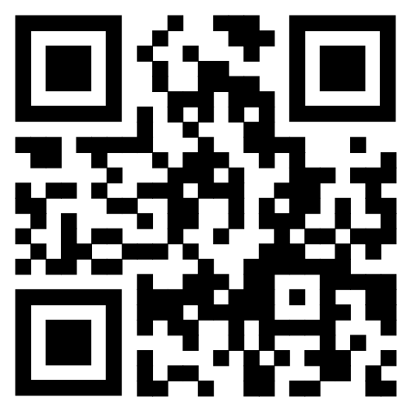
Additional Ways to Get the Most from This Book
The Reflections in each chapter
End of the chapter Problems
Design project – “Design Your Process” (See: Appendix A)

Slide 10
Think-Pair-Share Exercise
Take a few minutes to read the “Student
Testimonial” on Pages 5-7 of the text
Pair up with the person next to you and take
turns explaining the following:
What the student discussed in his/her testimonial
What reading the testimonial meant to you
One or two questions you have about what you read
Changes you are willing to make based on what you read
Be prepared to share what your partner
told you with the class.

