Slide 1

Notes:
A story about studying engineering – I got the idea from Dan Budny, Associate Professor Academic Director, Freshman Engineering Program. budny@pitt.edu. Telephone: 412-624-6474

Slide 2
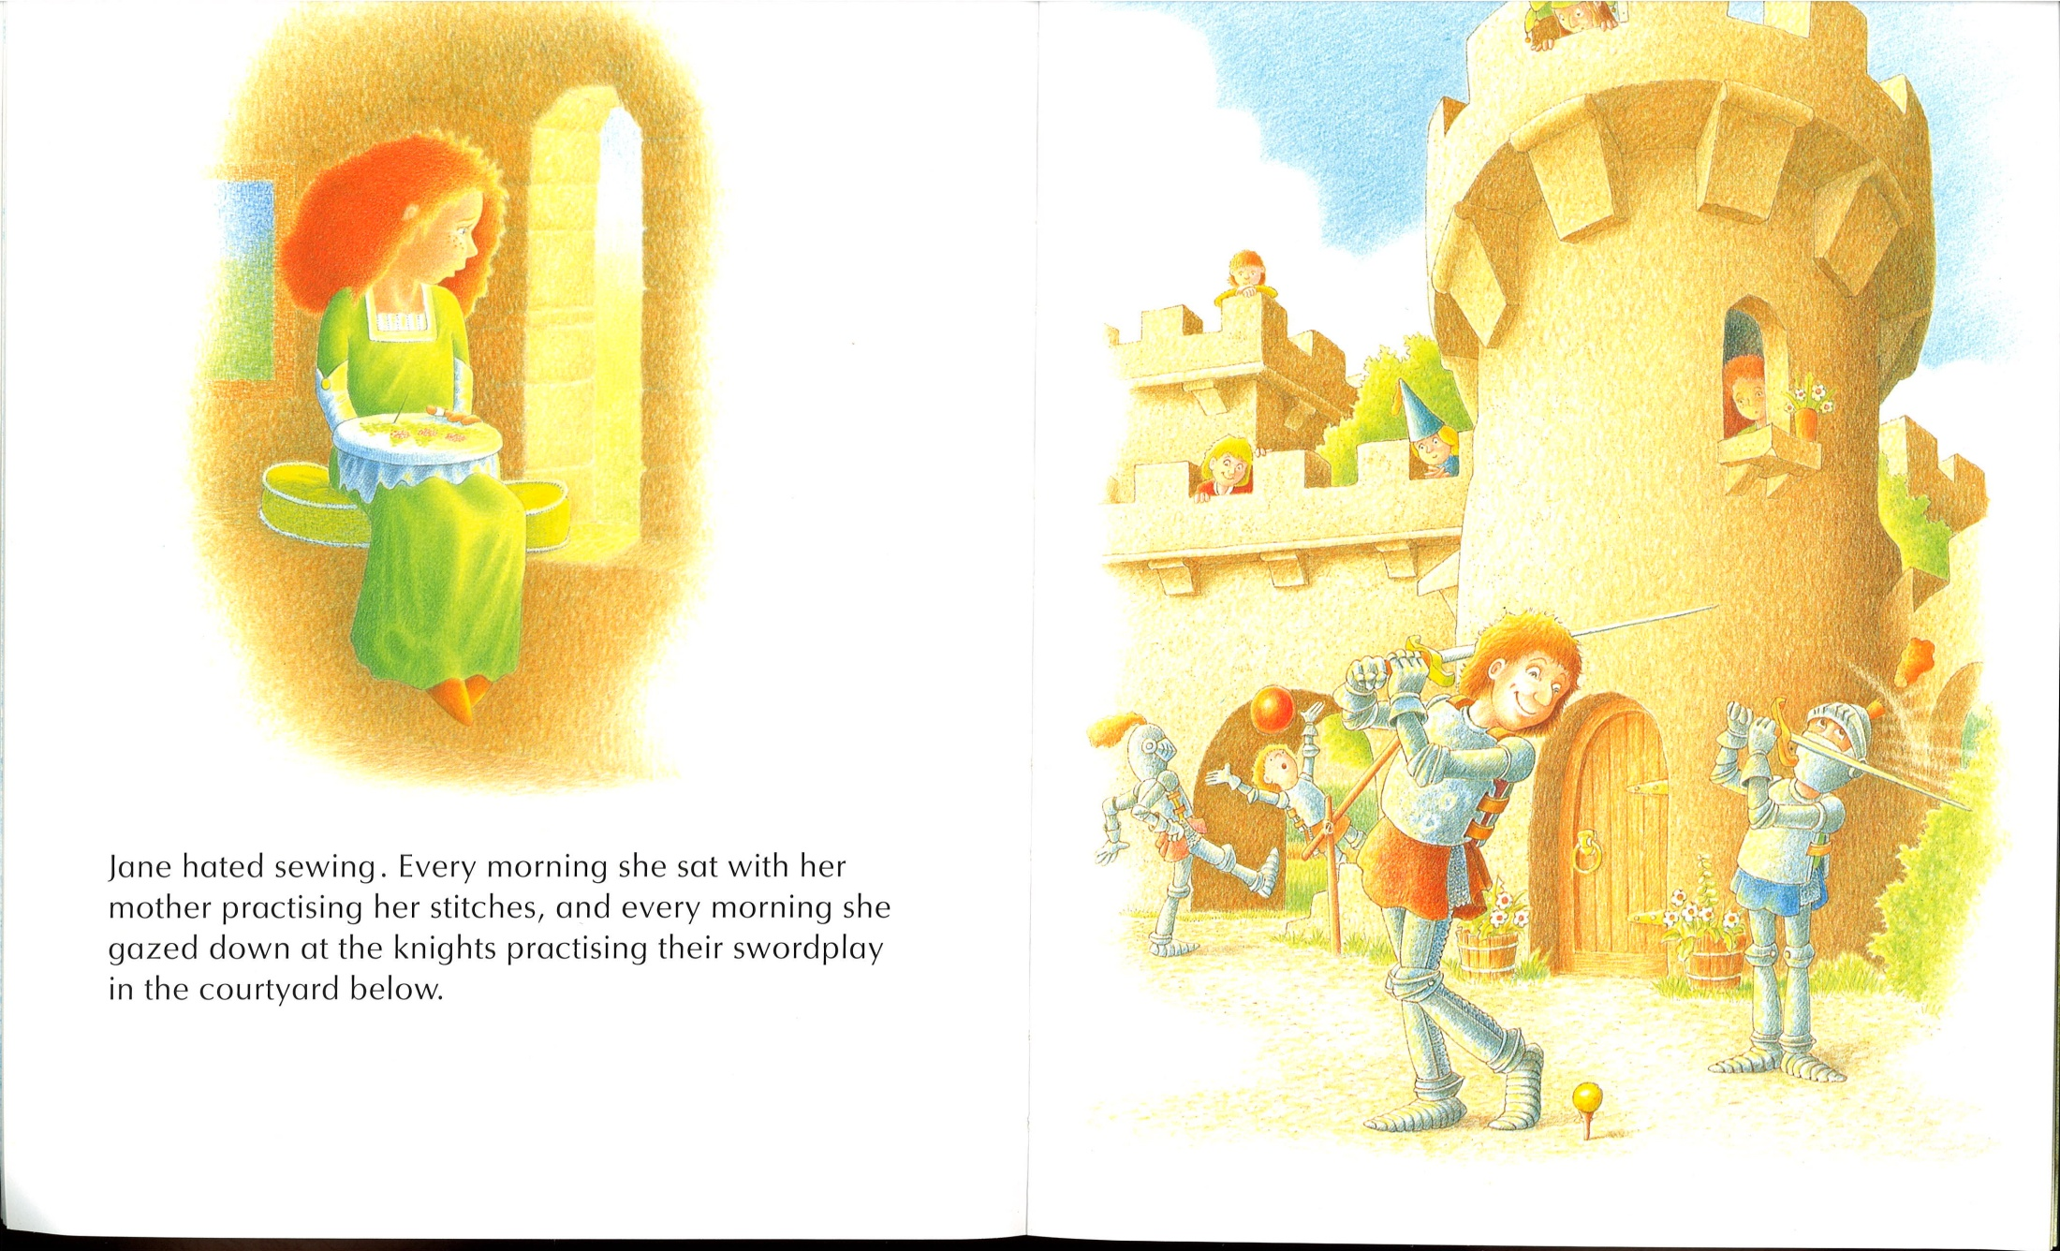
Notes:
Is Jane focusing on her homework? Is she distracted? Have you ever been distracted doing your homework?

Slide 3
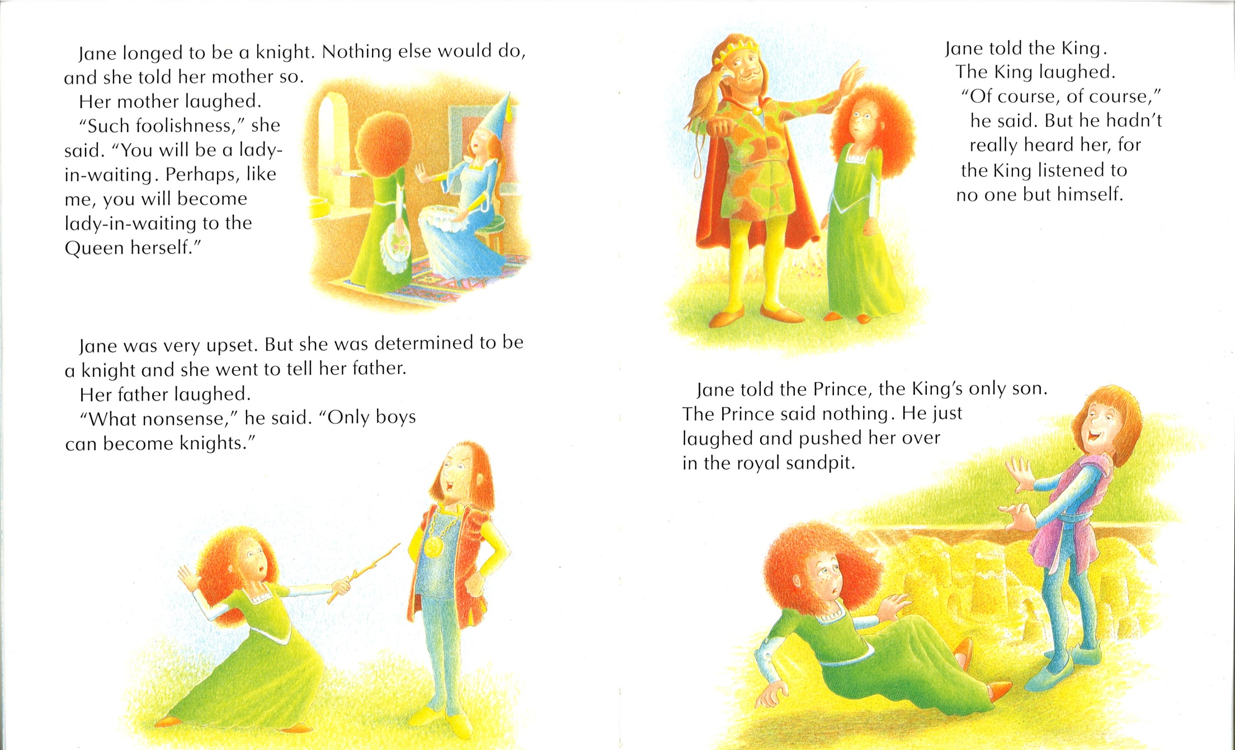
Notes:
Jane faces a lot of adversity here. Everybody tells her she can’t do it!

Slide 4
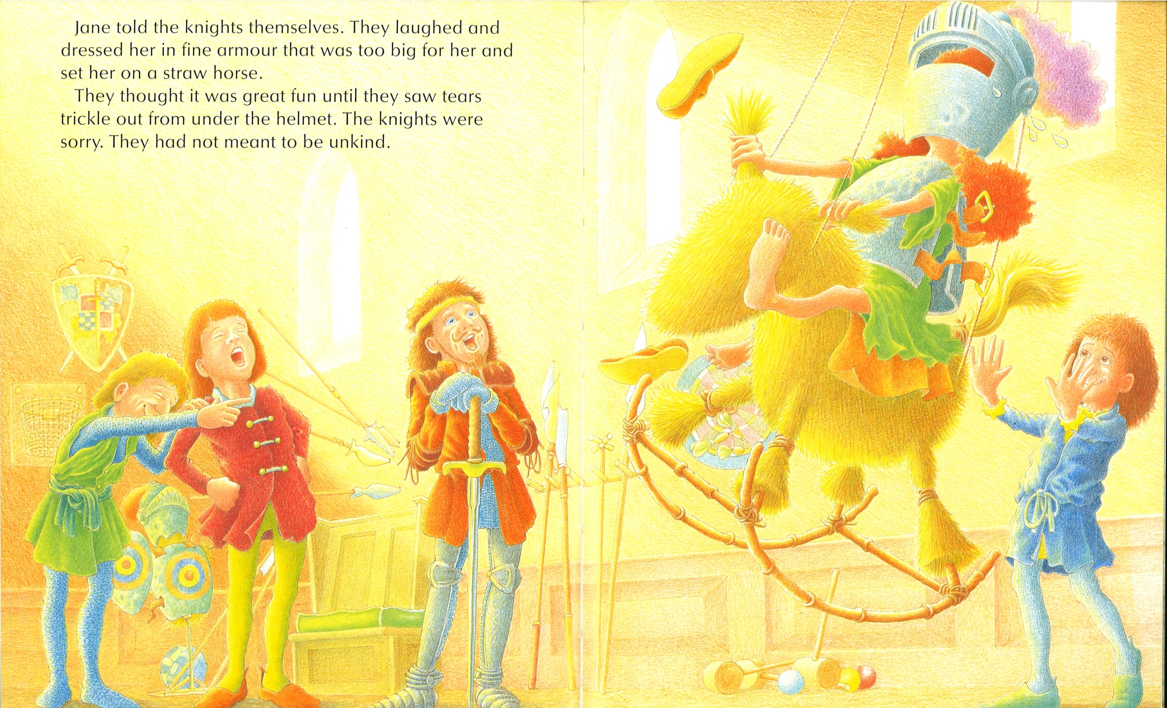
Notes:
The knights make fun of Jane. Do they believe Jane can become a knight?

Slide 5
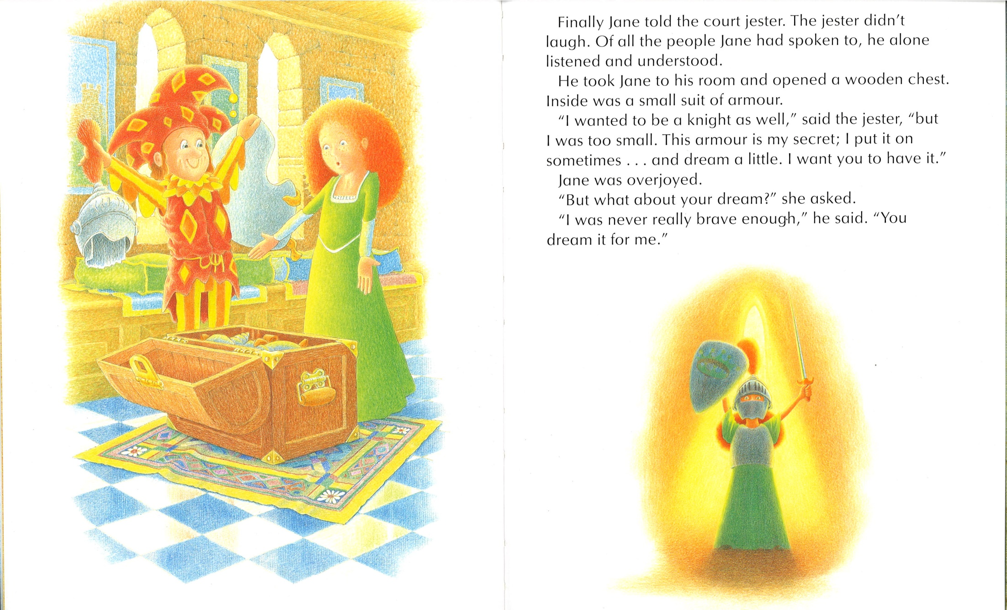
Notes:
The jester is helping Jane, he believes in her!

Slide 6
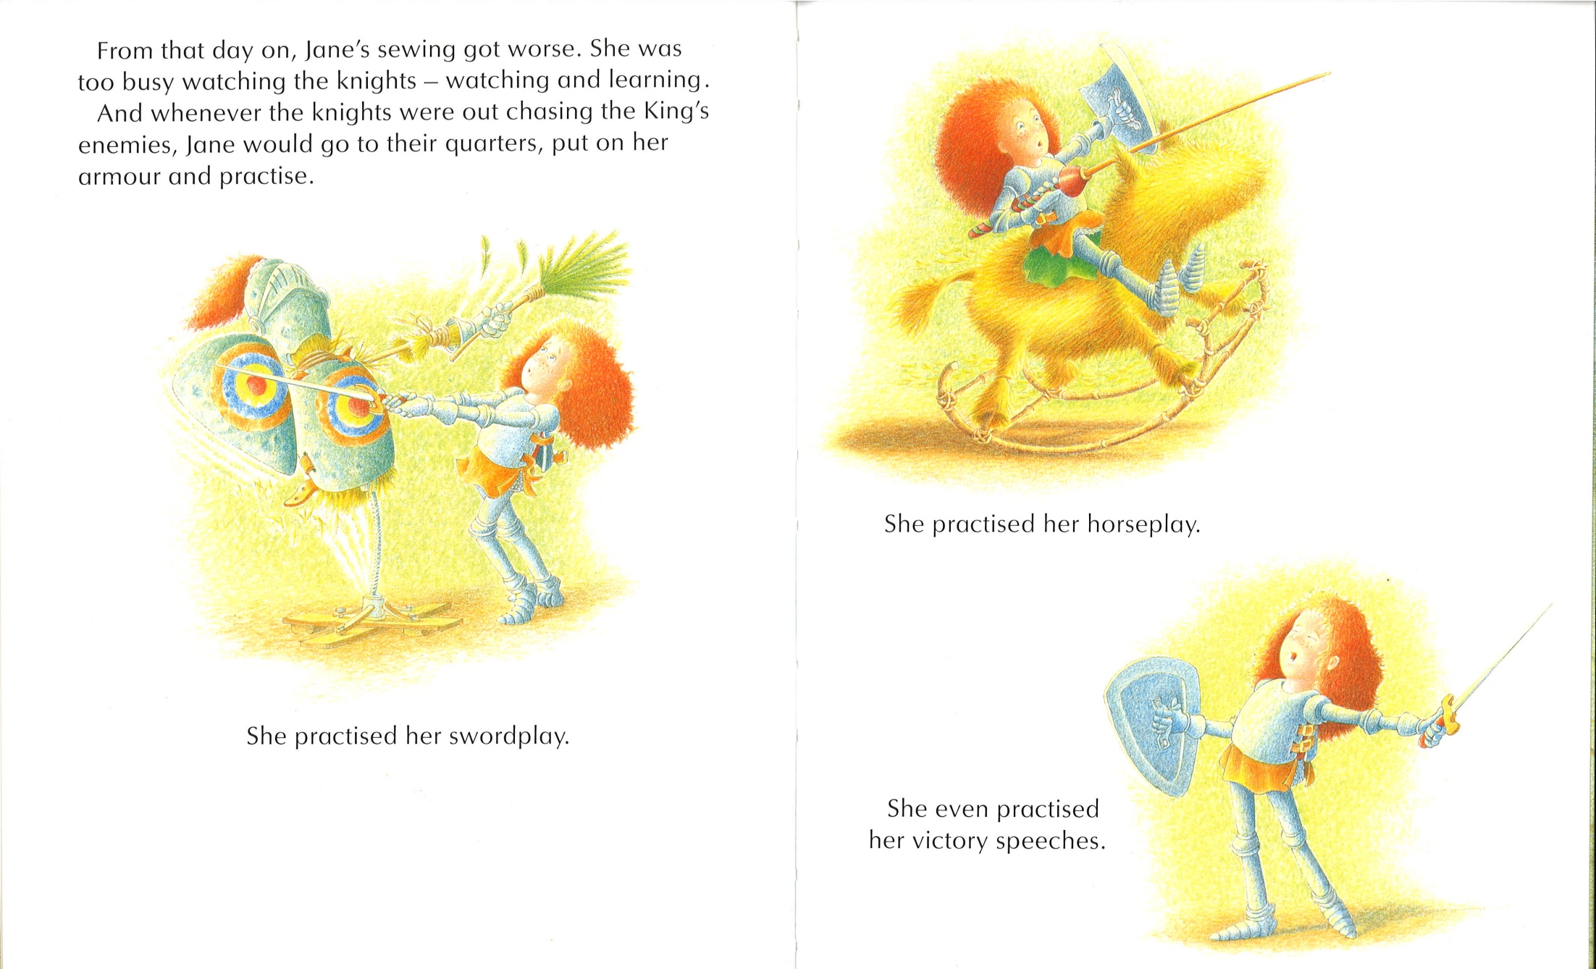
Notes:
Jane is determined to become a knight

Slide 7
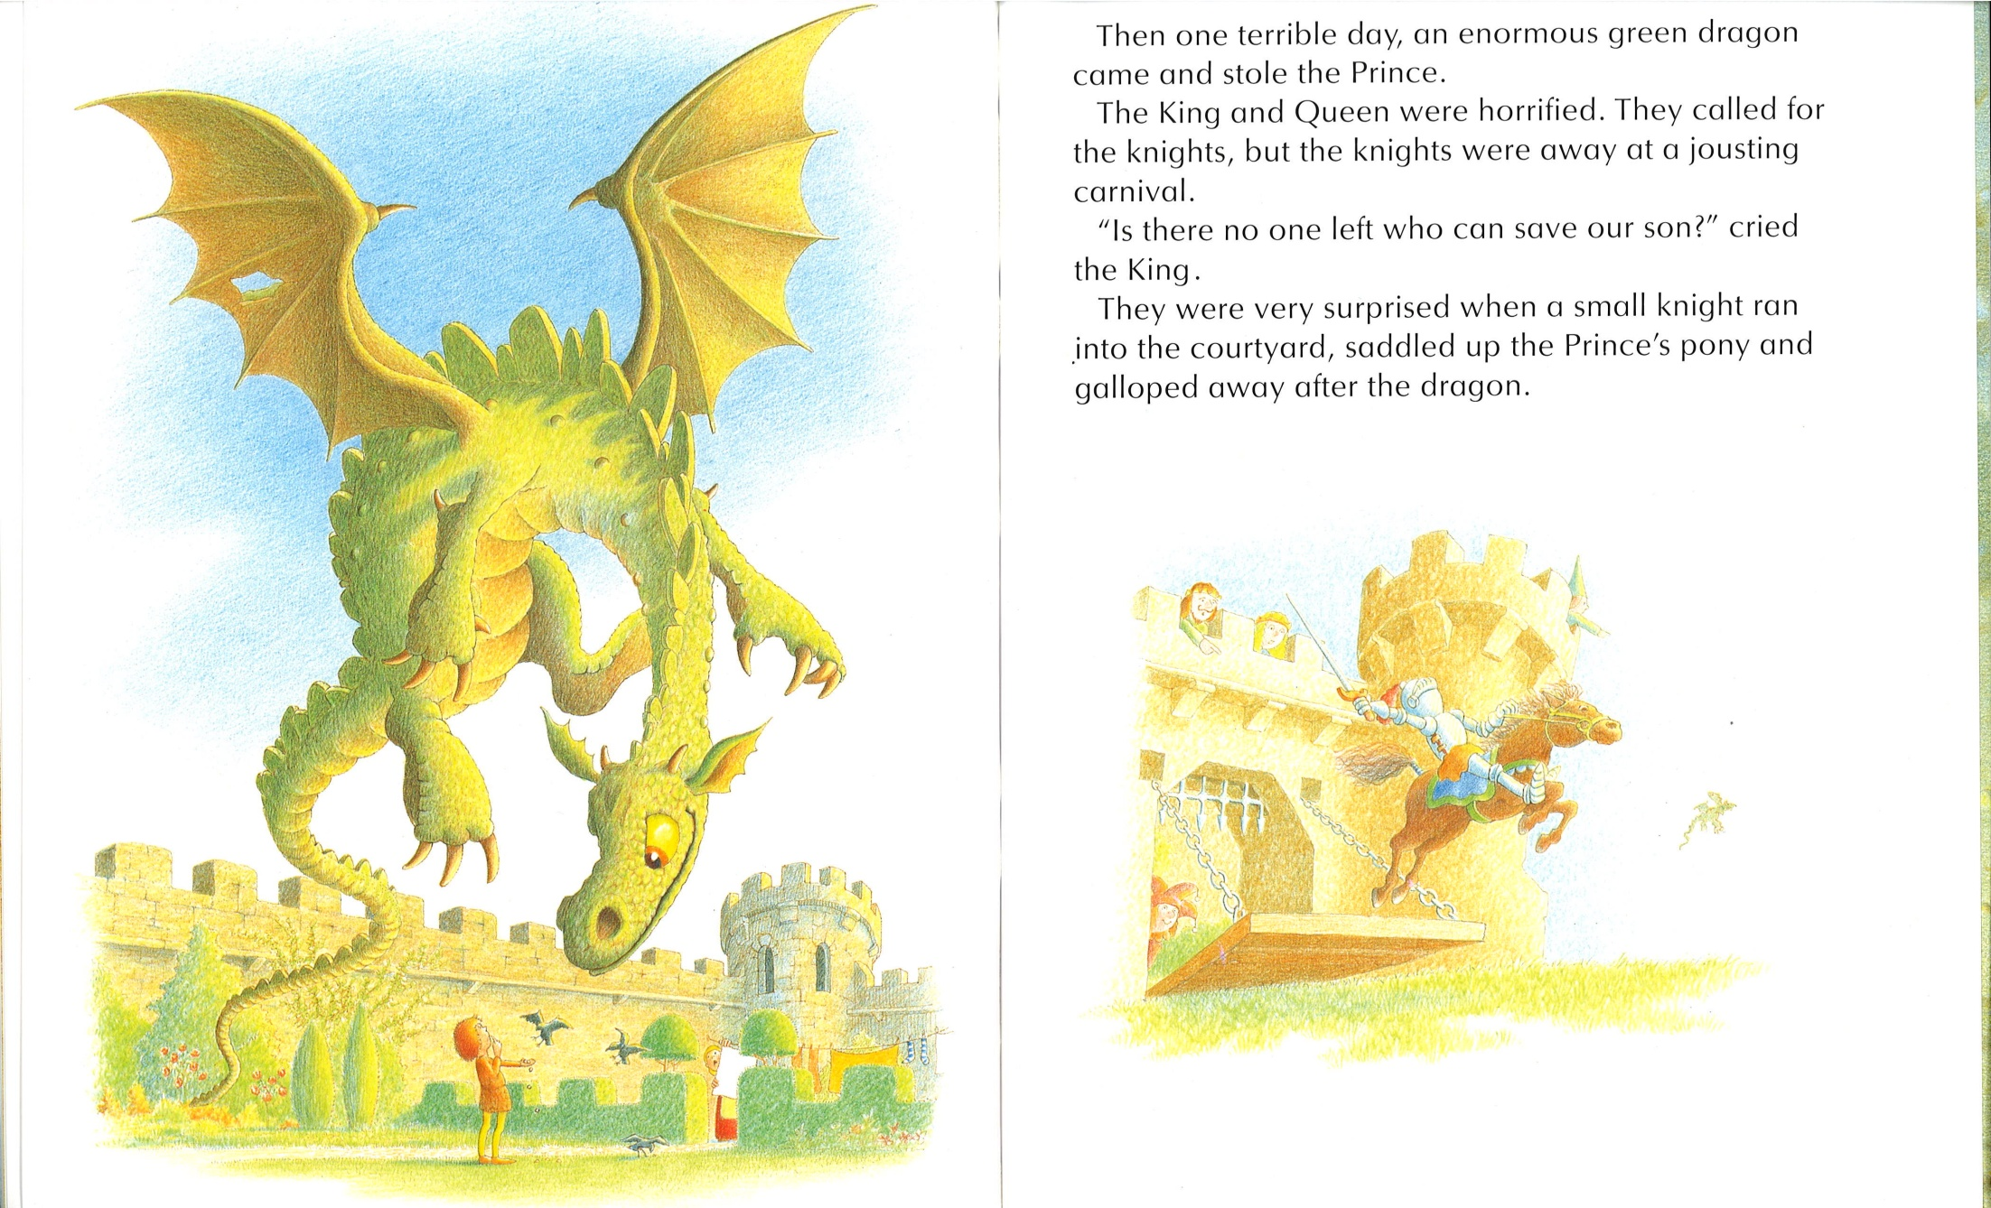
Notes:
The Prince get’s kidnapped by a dragon

Slide 8
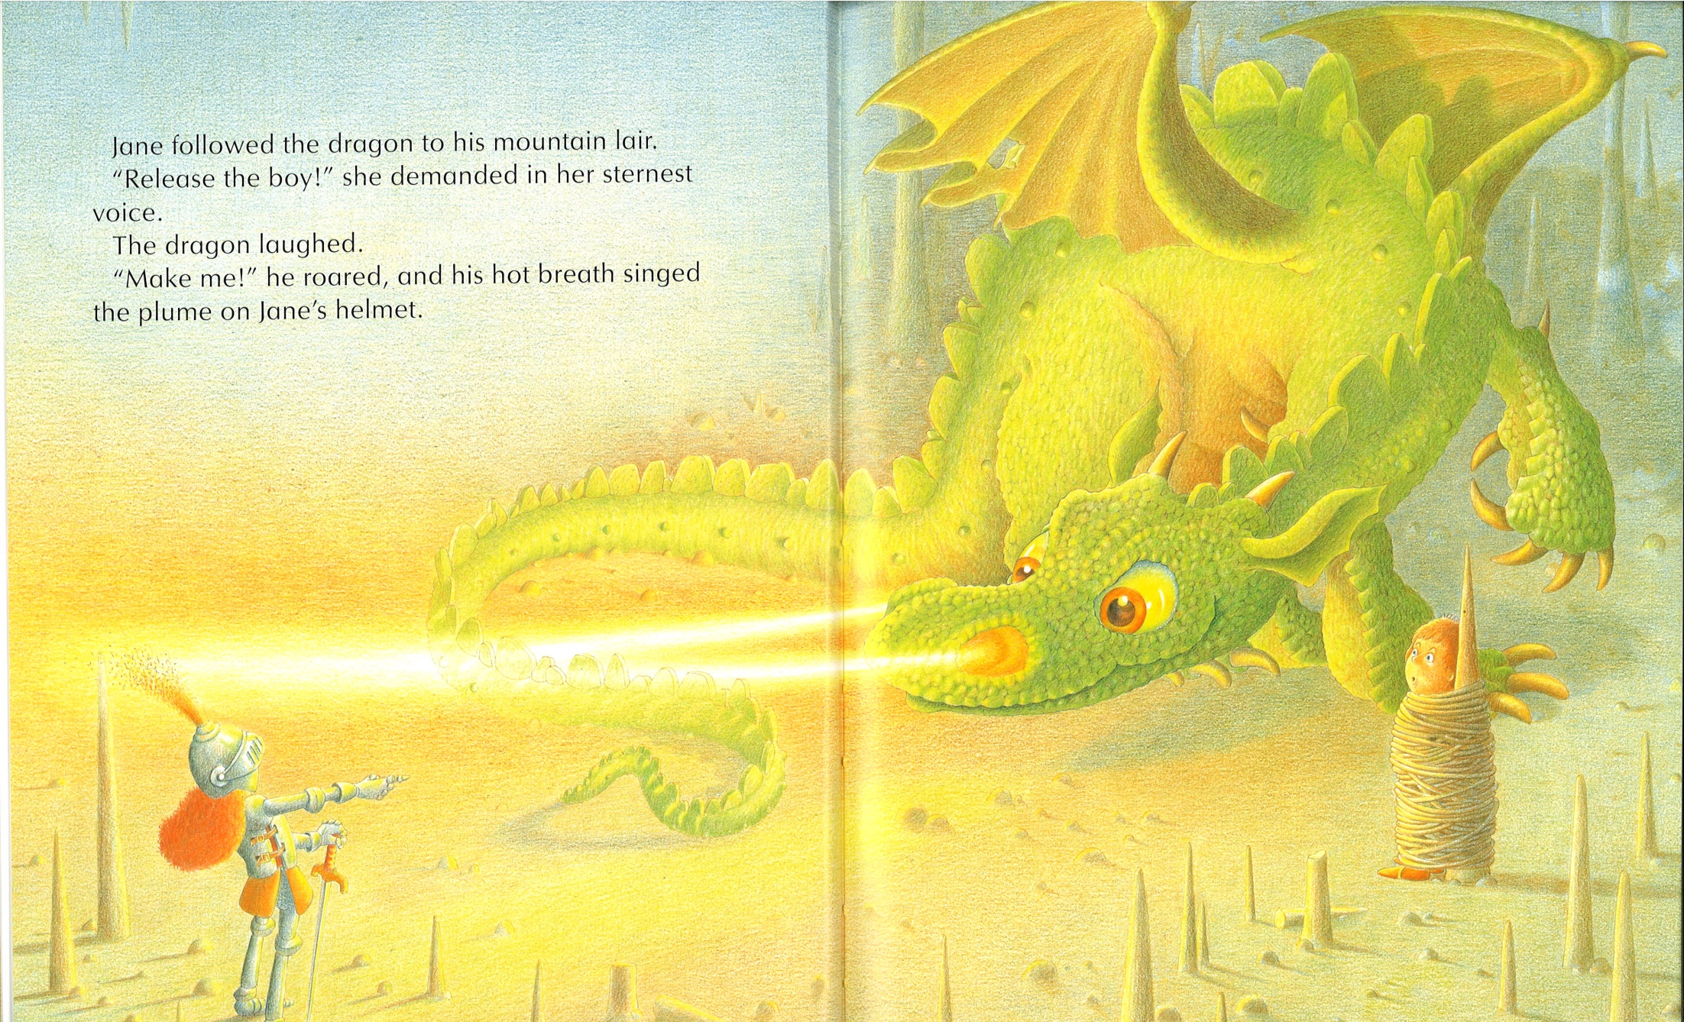
Notes:
What’s wrong with the picture? Look how precise the dragon singed her head, if he is that precise, why didn’t he toast her?

Slide 9
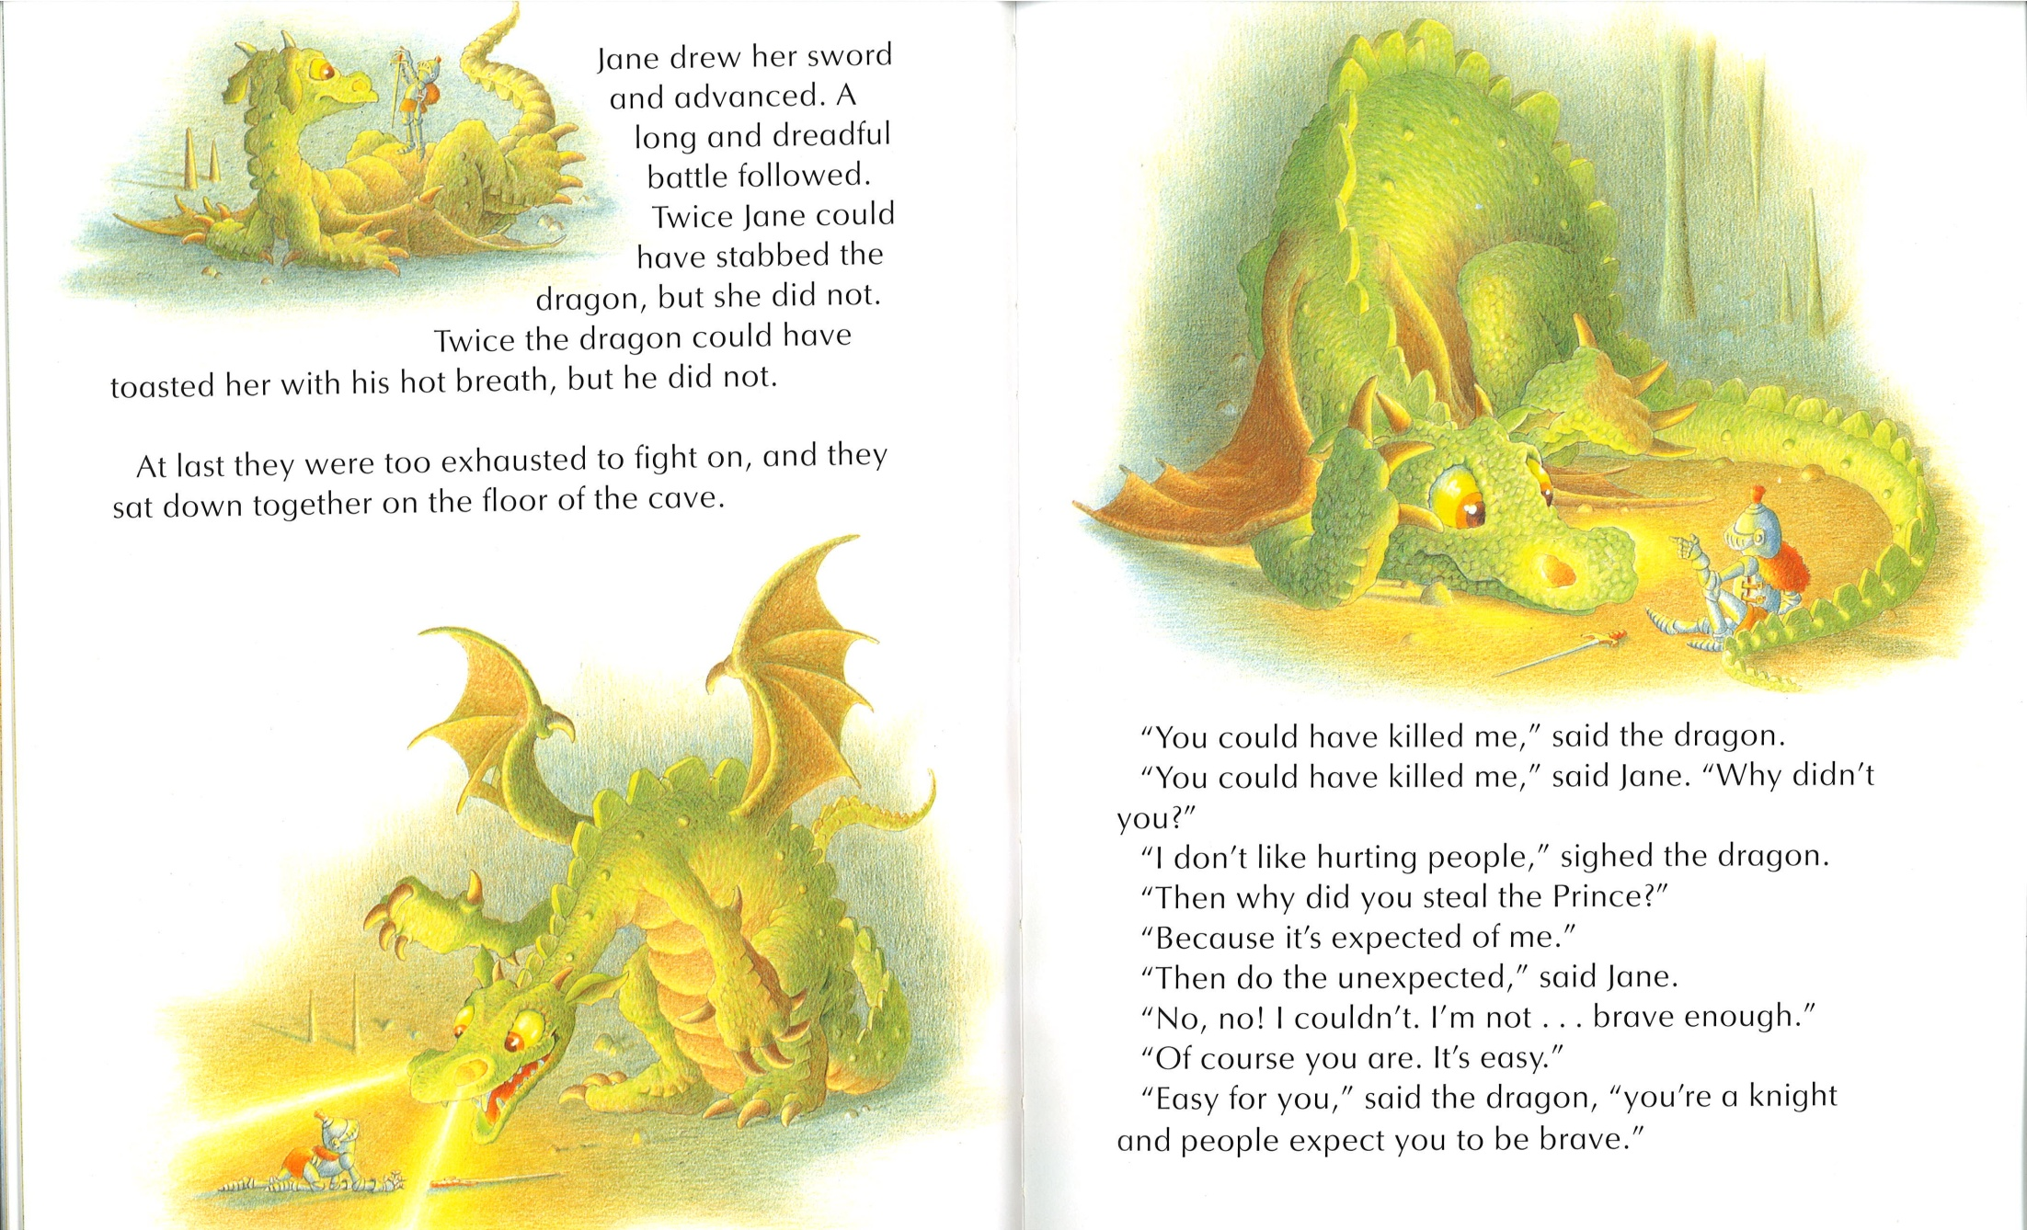
Notes:
Does the Dragon like to do what is expected from him?

Slide 10
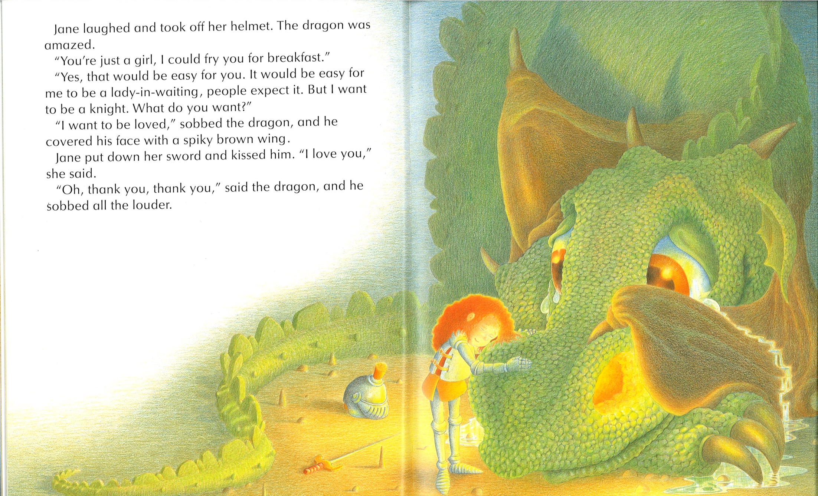
Notes:
Jane and the Dragon became friends! (they just had an intense fight!)

Slide 11
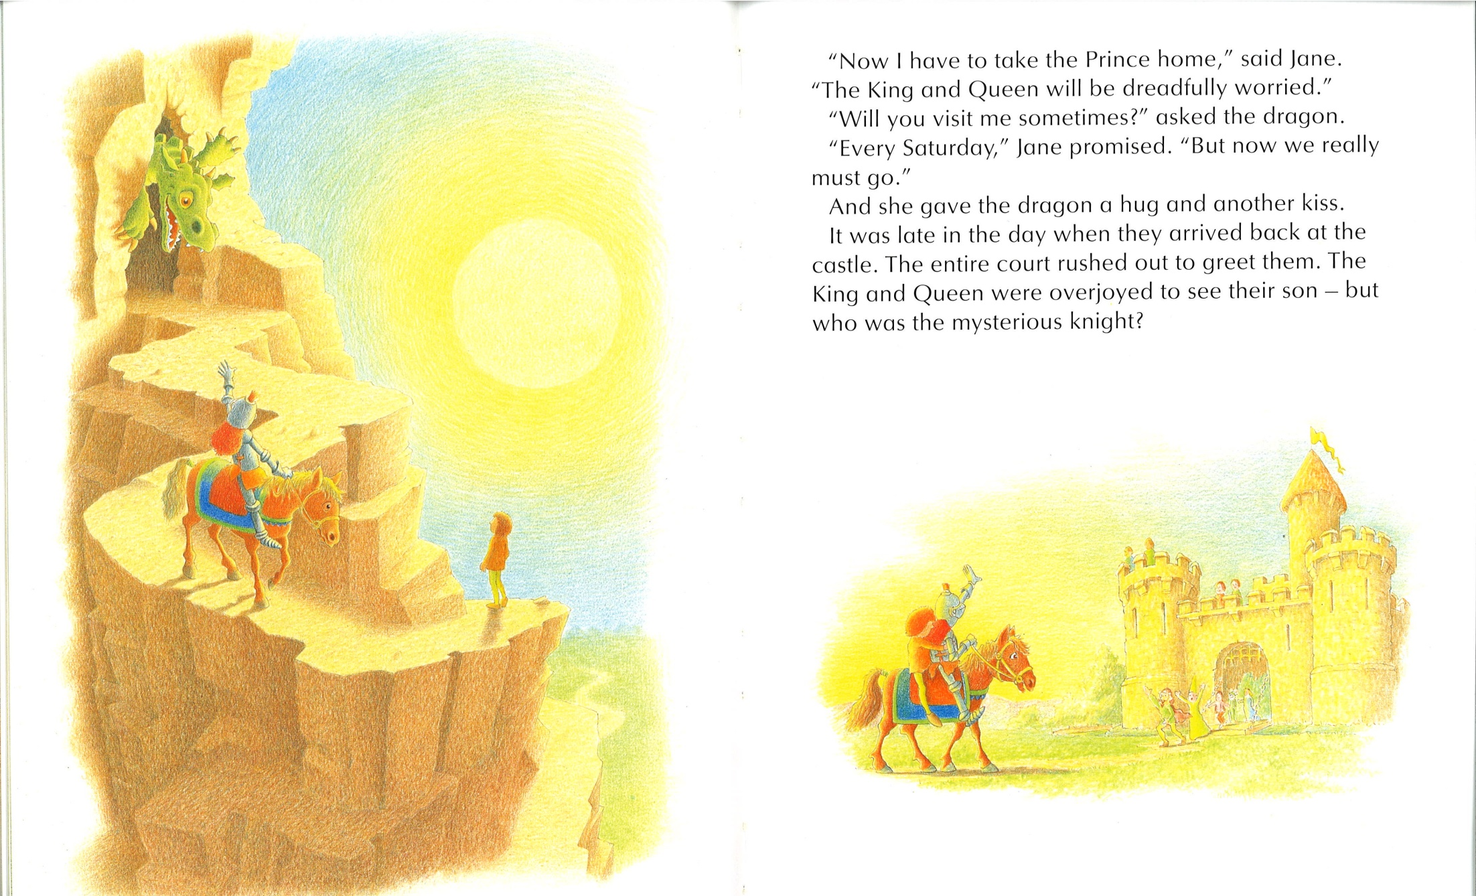

Slide 12
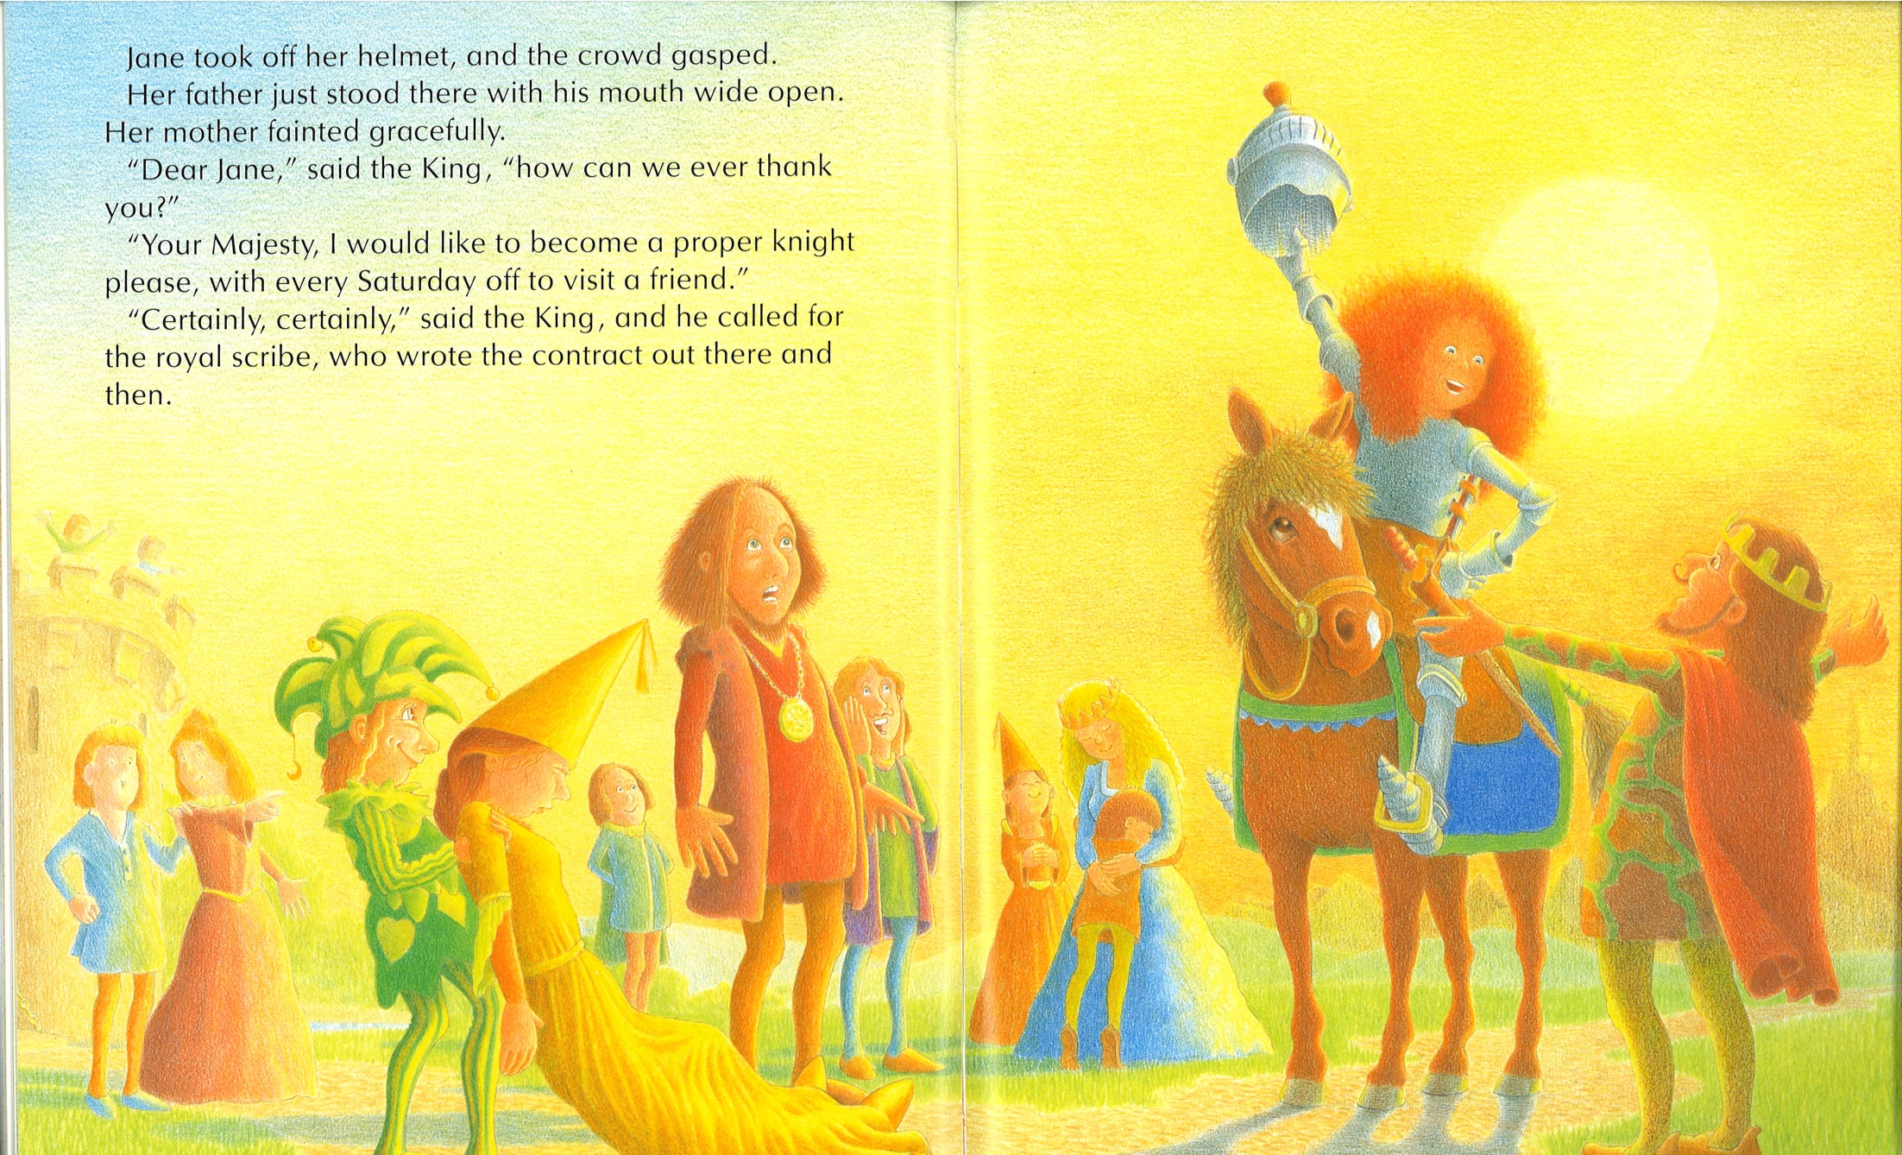
Notes:
Jane graduated!

Slide 13
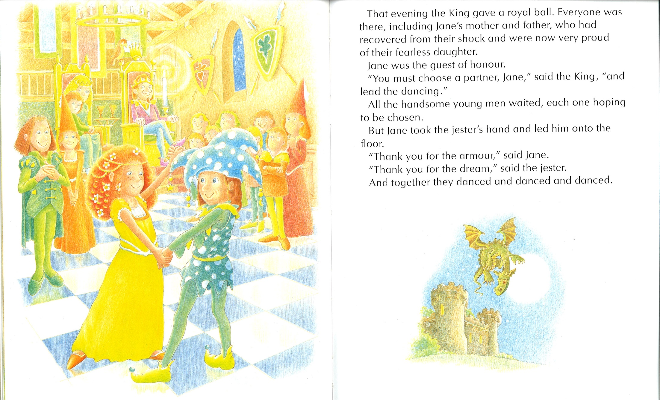

Slide 14
Things to think about…
Why are you here? Who made you come here (who is your jester, jester was always there for Jane and believed in her)
Jane made a choice and set a goal, to become a knight, everything else was irrelevant, and she practiced and practiced, nothing else mattered
Are you willing to do the same to become an engineer?
What’s your dragon? Math, Physics…Note how Jane made her Dragon become her friend/ally!

